Slide 1

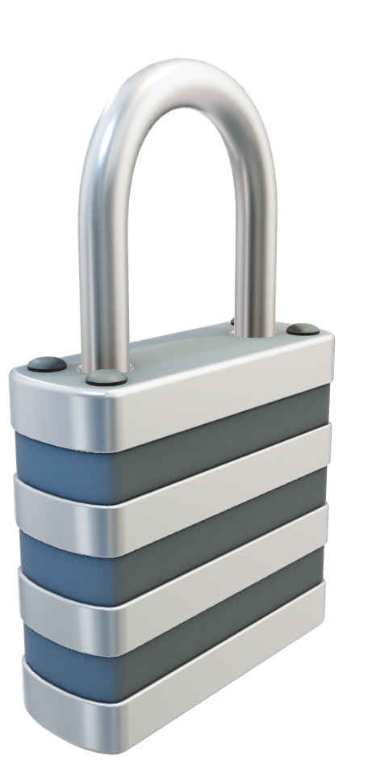
ISO27001
Sanam Makadia

Slide 2
What is ISO27001
International standard for an Information Security Management System (ISMS)
Risk based:
Not prescriptive about controls
You define the scope (Statement of Applicability)
Can be certified independently
Maps to other standards – NIST, ASD etc.
14 security domains, 114 controls
ISO series:
ISO27002: code of practice – detailed guidance on how to implement controls. Similar to NIST SP 800-53
ISO27004: security monitoring, measurement and analysis
ISO22301: Business continuity management

Slide 3
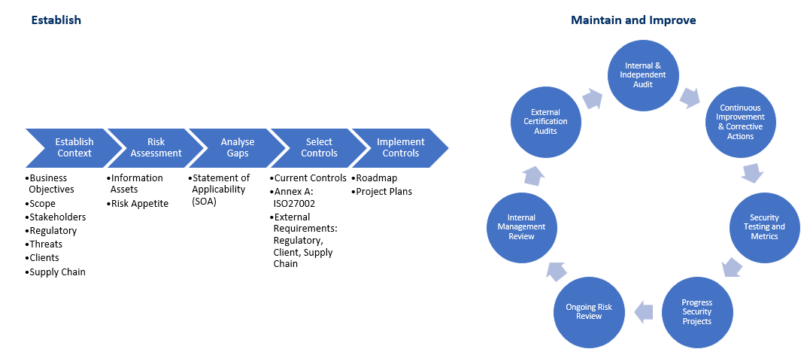
ISMS
Know your assets, assess your risks, select controls, maintain the system

Slide 4
ISO27001 Domains
Roles and responsibilities across all lines of business and users
Domain | Typical Process Owners
Management System: Context, leadership, planning, support, operations, performance evaluation, improvement – Clauses 4 to 10 | Senior Leadership team, risk & compliance, legal
Information Security Policy | Senior leadership team
Organisation of Information security | Senior leadership team, human resources, IT, project managers, marketing, finance
Human Resource security | Human resources
Asset Management | IT, finance
Access Control | IT
Cryptography | IT
Physical and environmental security | IT, Facilities
Operations Security | IT
Communications Security | IT
System acquisition, development and maintenance | IT
Supplier Relationships | Procurement, IT, any department that has a supplier (all)
Security Incident Management | IT
Business Continuity | All departments
Compliance | Risk & Compliance, legal

Slide 5
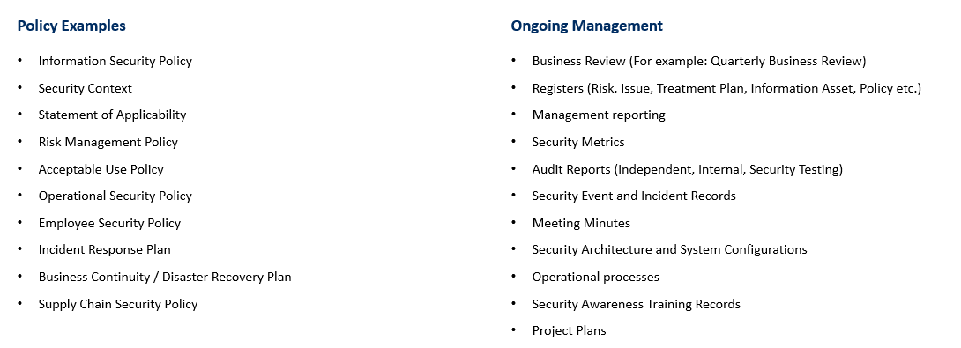
Typical Artefacts
Evidence required at each stage of Plan, Do, Check, Act

Slide 6
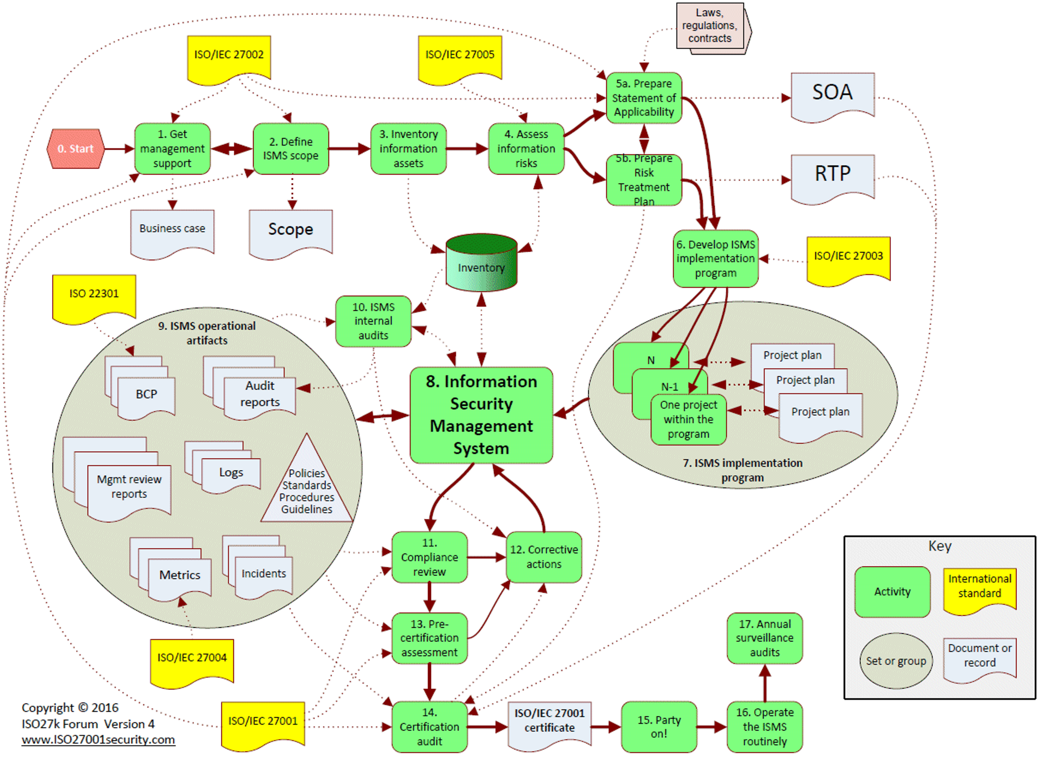
Integrated Components for ISMS
Complex and needs to be managed as a management system

Slide 7

Thank you

